Slide 1
Phase I Final Report
Presentation to Katz Executives
June 25, 2003

Slide 2
Contents
Page
Introduction 3
KGC Business Vision 4
Supply Chain Vision Revisited 7
Recommended Implementation Approach 15
Business Case to Support the Vision 19
Change Management Imperatives 29
Suggested Governance Model for Casper Going Forward 35
Casper Phase II 39
Conclusions 44

Slide 3
Introduction
This is the end of the beginning:
  this is the final presentation for the initial phase of Project Casper.
It consists of our finalized supply chain vision, the approach and business case to achieve that vision and a description of the recommended next phase for Casper.
Much of what we will be presenting today is a direct result of the visioning session and your constructive comments of June 12.
We believe that we have articulated the way forward for Katz’s supply chain, which is directly aligned with our overall business vision of being Canada’s premier healthcare provider.
The project team is asking for your approval to continue the journey that was started when we launched this initiative 11 weeks ago.

Slide 4
KGC Business Vision

Slide 5
Katz Group Canada Ltd: Vision for the Future
Strategic Intent
PharmaPlus / Rexall (our stores) will be the pharmacy of choice for the time-constrained female shopper seeking everyday health solutions, basics and seasonal merchandise for herself, her home and her family. We will be conveniently located, community stores that will provide current and innovative merchandise in an efficient, friendly and appealing shopping environment.
Mission Statement
We are dedicated to deliver value to our customers, associates and shareholders.
Customer Satisfaction Pledge
conveniently located
friendly, appealing environment
stocked shelves
targeted assortments
fair, everyday value
top of mind
Shareholder Pledge
achieve competitive returns in excess of cost of capital
provide growth and expansion capabilities
world class/rock solid
Associate Pledge
supportive and team oriented
clear roles, accountabilities and expectations
training and development

Slide 6
Katz Group Canada Ltd: Vision for the Future
Shared Values
ALL WITH
SPEED  EFFICIENCY  CONSISTENCY
passion for customers
respect for individual
open and honest communications
teamwork and sharing
commitment to innovation
drive for results
Our Winning Formula
We will achieve profitable sales growth through:
building superior leadership, teamwork and operational innovation
leverage our real estate portfolio
centralize and leverage our buying resources
build dynamic merchandise capabilities
establish stores dedicated to customers
focus on execution
create systems capabilities that deliver customer value
increase efficiencies by eliminating non-value added work
build effective relationships with our partners – vendors, etc.

Slide 7
Supply Chain Vision Revisited

Slide 8
Recommended Supply Chain Vision
A consumer-driven supply chain with collaboration and visibility across all trading partners controlled by Katz Group Canada
Guiding Principles
Build an organization to support supply chain excellence
Create a supply chain that is based on customer pull (demand) enabled by the store network
Provide visibility and control of inventory movement to Head Office
Manage and control the procurement of all products sold through KGC
Develop a single database of KGC product, sourcing and pricing
Provide real-time information when and where required
Leverage trust and collaboration between all trading partners
Understand and execute on the lowest cost to market
Build decision trees with clear responsibilities and accountabilities

Slide 9
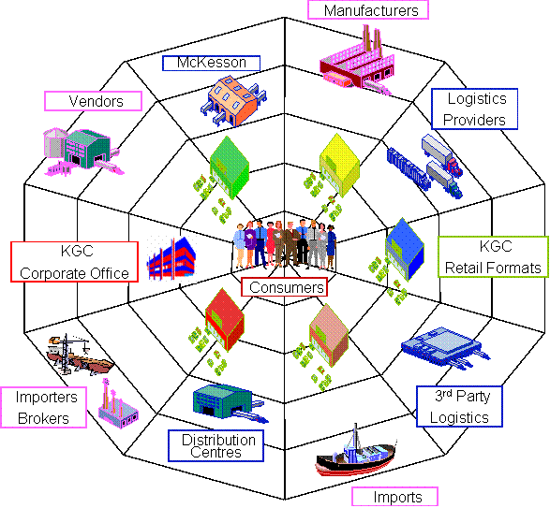
It is not a Supply Chain but a Supply Web
Organization with defined roles
One set of shared information
Close to real time information
Supported by integrated systems that connect
Close and deep collaboration: sharing the gains
Manage by exception

Slide 10
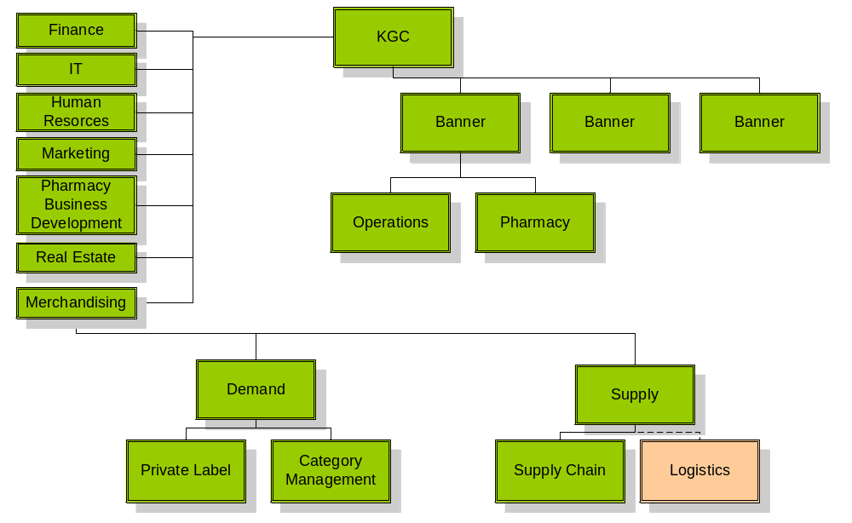
The Katz organization must change to support the vision including implementing a shared services model
Shared Services

Slide 11
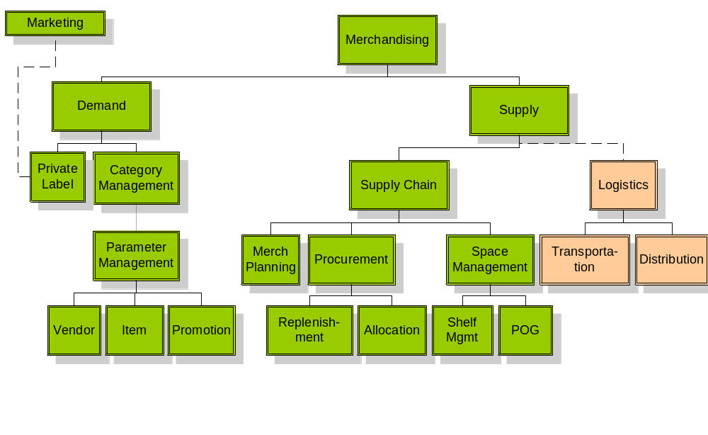
The supply chain organization’s focus will be on balancing demand and supply

Slide 12
Process improvements are necessary to support the vision …
Plan
Buy
Move
Sell
Merchandise Planning
Replenishment Flow Strategy
Buying Plans
Parameter Mgmt: Item, Promotion, and Vendor Mgmt
Planograms: Space & Floor Planning, Clustering, Shelf Assortment
Item Assortments
Purchase Order Management
Allocation of Orders
Forecasting and Replenishment
Inventory Management
Vendor Managed Inventory
Invoice Matching
Trade Funds Management
Outsourced or Self Provision
Receiving
Transportation Mgmt
Prepare Merchandise
Transfer and Returns
Warehouse Replenishment
Customer Fulfillment
Track Results to Targets
Item and Category Performance
Supplier Performance Metrics
Store-level Receiving, Inventory and Replenishment

Slide 13
… and will be supported by technology enablers
Plan
Buy
Move
Sell
Merchandise Planning System
Retail Management System
Collaborative Planning, Forecasting & Replenishment
Space Management
Enterprise Resource Planning
Advanced Planning System
Purchase Order Management System
Allocation
Replenishment
EDI , XML ordering
Collaborative Planning, Forecast & Replenishment
Supplier Relationship Management (Vendor Scorecards)
Outsourced or Self Provision
Appointment Scheduling
Replenishment
Transportation Management System
Warehouse Management System
Collaborative Planning, Forecasting & Replenishment
Advanced Planning Systems
Point of Sale
Scan-based Trading
Data Warehouse (Reporting)
Intranet/Extranet

Slide 14
Staff roles and responsibilities will be aligned with the vision
The shared services model will allow for the standardization of processes and performance measurements and will improve KGC’s ability to manage staff across banners.
The clearly defined roles and responsibilities will allow for the creation of standard skills templates, development programs and succession planning. This will prompt the need to establish a training management program.
Store management skills and job activities will be focused on analyzing data and decision-making vs. tactically reacting to local conditions.
The new model will require a change management competency to support continuous growth and agility.
A communication program must be a core component of the change management competency.
The Katz culture needs to be harmonized across the enterprise.

Slide 15
Recommended Implementation Approach

Slide 16
How is KGC Going to Achieve the Vision?
Legend
Low
High
Path | Benefits | Cons | Costs | Time | Risks
Buy | Obtain supply chain skills Can buy only parts that you choose to insource (i.e. front shop) | Integration challenges Potentially acquire more assets than are necessary for KGC business
Build | Potential to create strong internal buy in Custom designed for Katz needs | Internal supply chain skills do not exist
Rent | Focus on core competency Improved flexibility Leverage best practices from 3PL Conservation of capital Leverage economies of scale | Do not have full control Coordination issues Do not gain internal skills Costly in the long term
Mixed Mode | The final approach will consist of a combination of all of these options.

Slide 17
To accelerate time to benefit, a business release approach is recommended, realizing major benefits in 2004 and 2005
BR 3
Manage Store Labour
Business Intelligence
BR 2
Manage 3PL for Front Shop
Match
Invoices
Optimize Price
Manage Purchase Orders
Manage Vendor
POS
(March 2005)
CPFR
Interface
Manage
Replenish-ment
BR 1
Create Inventory Visibility
Forecast Demand
Legend
ERP
(July 2004)
LOG
Manage Direct Store Delivery
Manage Promotion
POS
Quick
Hits
Interface
Manage
Trade
Funds
RMS
Supply Chain
Design & Solution Selection
Manage Item / Price
Plan Store Specific Assort- ment
Allocate Merchan-dise
ERP
BR 0
EIS
2003
Jan 2004 – Sep 2004
Oct 2004 – Mar 2005
Apr 2005 – Sep 2005

Slide 18
The business release approach ensures the focus stays on benefits and capabilities, not just systems
 | Business Release 1 | Business Release 2 | Business Release 3 | McKesson Dependent Opportunities
Description | Common Item Master One Price Book Promotion Mgmt Store Level Clustering Perpetual Inventory (POS-dependent) | Purchasing Allocations Replenishment Merchandise Planning Shelf Space Planning Vendor Mgmt | Retail Intelligence Profit Optimization Labour Scheduling | CPFR Improve Logistics Network Trade Funds Management
Reduced Inventory
Reduced Inventory Write-offs
Increased Sales
Leverage Purchasing Power
Improve Markdown Management
Improve Gross Margin Contribution

Slide 19
Business Case

Slide 20
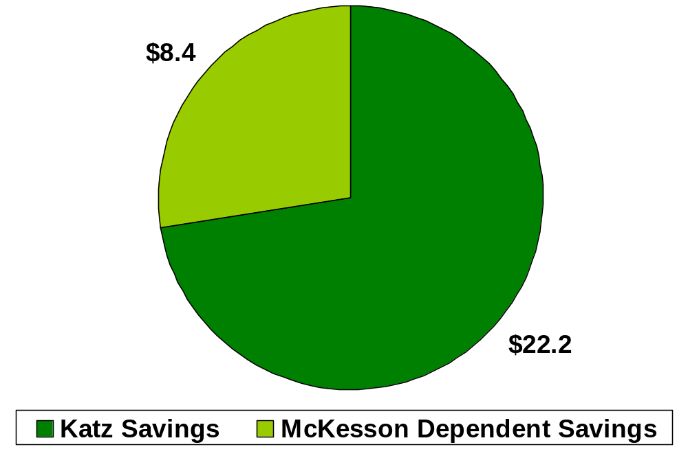
Based on our data analysis, comparison to benchmark information and very conservative assumptions, Casper offers significant benefits to KGC
Reduced Inventory $3.5M
Increased Sales from Improved In-Stocks $11.6M
Decreased Markdowns $4.5M
Increased Sales from Merchandising Optimization $8.1M
Improved Gross Margin Contribution $2.9M
TOTAL $30.6M

Slide 21
Reduced Inventory
Benefits Assumptions
Only corporate store level inventory is considered
Improving inventory turns to 5.9 will result in a cash flow improvement of $28.9M and a yearly carrying cost savings of $3.5M
Carrying cost % is assumed to be 12%
Inventory turns can be improved by:
  Reducing discontinued inventory
  Reducing excess inventory
  Improving inventory turns on low performing DSD vendors (i.e. cosmetics, greeting cards)
Potential Benefits (‘000,000’s)
Total Corporate Inventory $170.0
Cost of Goods Sold $830.0
Inventory Turns 4.9
Best in Class Inventory Turns 7.4
Inventory at Best in Class $112.2
Inventory Reduction – Potential $57.8
Realization Rate 50%
Inventory Reduction - Realizable $28.9
Carrying Cost Savings $3.5

Slide 22
Increased Sales from Improved In-Stocks
Benefits Assumptions
Assume that current customer service level is 90% which is equivalent to McKesson’s global service level to stores
Assume gross margin is 27% from 2003 corporate plan
Improving service levels to 93.25% will improve profitability by $11.6M
Service levels can be improved via
  Improved planning
  Improved forecasting
  Improved inventory visibility
Potential Benefits (‘000,000’s)
Corporate Sales $1150.0
Current Service Level 90%
Lost Sales at Current Service Level $127.8
Best in Class Service Level 96.5%
Lost Sales at Best in Class Service Level $41.7
Lost Sales Reduction - Potential $86.1
Realization Factor 50%
Lost Sales Reduction – Realizable $43.0
Gross Margin 27%
Lost Sales Reduction – Profitability Impact $11.6

Slide 23
Decreased Markdowns
Benefits Assumptions
Estimate that current Markdowns are 2.5% of sales based on industry average
Assuming an improvement in markdowns to 1.75%, the realizable savings is $4.5M
Potential Benefits (‘000,000’s)
Front Shop Corporate Sales $598.0
Current Estimated Markdown % 2.5%
Current Estimated Markdowns $15.0
Best in Class Markdown % 1%
Markdowns at Best in Class $6.0
Markdown Improvement – Potential $9.0
Realization Factor 50%
Markdown Improvement – Realizable $4.5

Slide 24
Increased Sales from Merchandising Optimization
Benefits Assumptions
Assume merchandise optimization will improve front shop revenues by 5%
A 5% increase in front shop revenue, $30M will result in a $8.1 million improvement in profit
Potential Benefits (‘000,000’s)
Front Shop Corporate Sales $598.0
BIC Revenue Improvement from Merch Opt. 10%
Revenue Improvement – Potential $59.8
Realization Factor 50%
Revenue Improvement – Realizable $29.9
Gross Margin 27%
Revenue Improvement – Profitability Impact $8.1

Slide 25
Improved Gross Margin Contribution
Benefits Assumptions
Assume that improvements in category management will increase gross margin by 0.25%
A 0.25% increase in gross margin is equivalent to a $2.9M improvement in gross margin
Potential Benefits (‘000,000’s)
Corporate Sales $1150.0
Current Gross Margin % 27%
Current Gross Margin $ $310.5
Gross Margin % Improvement 0.5%
Gross Margin $ Improvement $5.8
Realization Factor 50%
Gross Margin Improvement – Realizable $2.9

Slide 26
Other Benefits Areas
There are other benefits areas that are either dependent on changing the McKesson contracts, or for which assumptions are too nebulous.
  Reducing logistics expense: Currently paying McKesson 4.9%, Shoppers Drug Mart is paying 3.2%. This opportunity is contingent on negotiating the terms of the agreement with McKesson.
  Capturing lost discounts: Currently McKesson is capturing prompt payment discounts from vendors accounting for approximately $10M per year.
  Forward buying savings: Potential savings in the neighborhood of 10-20% of acquisition costs for particular SKU’s
  Improving payment terms: Current DPO is 38 days, Best in Class is 58 days. The majority of outstanding accounts payable is with McKesson, most opportunities involve renegotiating terms with McKesson.
  Leverage purchasing power: Managing and controlling purchase orders in house will allow Katz to leverage purchasing power. Best guess is reducing purchasing cost by 2% of direct spend or approximately $16.6M annually.
  Reducing inventory write-offs: Better planning and in-store inventory positions will result in decreased damage and theft. Estimates are approximately $0.85M annually.

Slide 27
We have developed cost estimates for the entire lifecycle of Casper
 | Business Release 0 | Business Release 1 | Business Release 2 | Business Release 3 | Total
Duration | 9 months Apr 2003 – Dec 2003 | 9 months Jan 2004 – Sep 2004 | 6 months Oct 2004 – Mar 2005 | 6 months Apr 2005 – Sep 2005 | 30 months
Cost ($M) | $1,300 | $7,940 | $7,596 | $6,152 | $22,988
Assumptions
10 external FTEs for implementation support for BR1, BR2 and BR3
16 internal FTEs for implementation support BR1, BR2 and BR3
800 RMS user licensees required: two per store x 300 stores + 200 at HO = 800
Ongoing maintenance costs are $1.1M per year after BR3

Slide 28
The business case shows accelerated time to benefits as well as a strong rate of return
Benefits | 2003 | 2004 | 2005 | 2006 | 2007 | 2008 | NPV (6%) | NPV (10%)
Business Release 0 | $500 | $1,000 | $0 | $0 | $0 | $0 | $964 | $1,281
Business Release 1 | $0 | $0 | $1,622 | $3,243 | $3,243 | $3,243 | $9,708 | $8,806
Business Release 2 | $0 | $0 | $0 | $4,323 | $8,647 | $8,647 | $16,940 | $14,523
Business Release 3 | $0 | $0 | $0 | $0 | $5,141 | $10,283 | $11,756 | $9,896
Total Benefits | $500 | $1,000 | $1,622 | $7,566 | $17,031 | $22,173 | $37,074 | $30,758
Costs
Hardware Costs | $0 | $725 | $225 | $0 | $0 | $0 | $884 | $845
Software Costs | $0 | $1,700 | $2,150 | $0 | $0 | $0 | $3,517 | $3,322
External Implementation Costs | $1,000 | $6,264 | $4,516 | $0 | $0 | $0 | $10,309 | $9,478
Internal Implementation Costs | $300 | $2,286 | $1,576 | $0 | $0 | $0 | $3,640 | $3,345
Maintenance/Support | $0 | $765 | $1,100 | $1,100 | $1,100 | $1,100 | $4,317 | $3,865
Total Costs | $1,300 | $11,739 | $9,949 | $1,100 | $1,100 | $1,100 | $22,495 | $20,413
Net Benefits | ($800) | ($10,739) | ($8,327) | $6,466 | $15,931 | $21,073 | $14,579 | $9,456
Internal Rate of Return is 31%
All figures in $M

Slide 29
Change Management Imperatives

Slide 30

To help achieve the Casper vision, there are four Change Management recommendations
1. Communication Strategy and Plan
Identify key stakeholder communication needs, develop a two-way communication plan, and deliver key messages
2. Ongoing Project Evaluation
Monitor and Measure change, culture, teaming, leadership, and communication effectiveness
3. Performance and Skills Management
Identify new performance measurements; assess skills required to support the process changes; redesign jobs/organization; identify skills gaps, and build training strategy for core team and end users
4. Training Program
Develop a comprehensive training program which identifies learning requirements; facilitates access to training courses; focuses on both the project team and end users
Change Readiness Issues

Slide 31
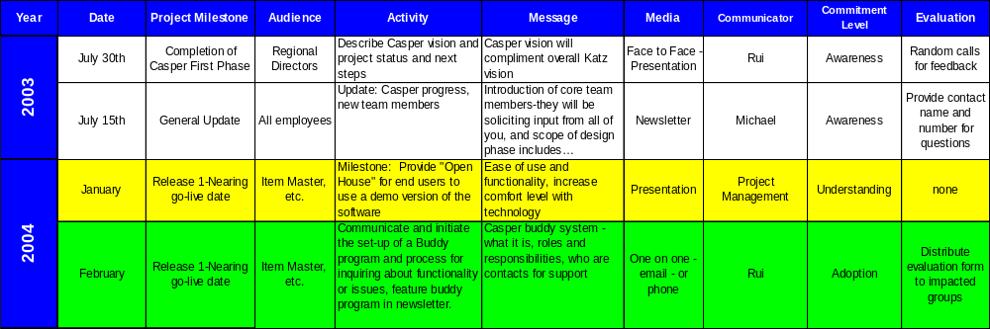
A structured communication strategy and plan will enable the right messages to be delivered to the right audience at the right time
Components:
  Identification of audience communication needs
  Selection of appropriate communication delivery vehicles
  Structured scheduling of communication messages
Sample

Slide 32
By conducting on-going project evaluations, Katz will be in a position to understand project performance and take corrective action when required
Components:
  Communication effectiveness evaluations
  Change readiness re-evaluation
  Team charter workshop (culture, norms, behaviours)
  Team effectiveness survey
Sample Core Team Effectiveness Survey Results
Dimension | Avg. | High Score | Low Score | Implications
a) Purpose and vision of Casper | 2.7 | 5 | 1 | a) Leaders average is 3.0, members 2.5 Although some team members have a clear vision of the project goals, there is a signification difference in perceptions and understanding within the team. Suggests lack of communication and alignment
b) Project Goals and Objectives | 2.3 | 5 | 1
c) Goal Alignment | 2.3 | 5 | 1
Comments
I have not seen either the vision or objectives Divisions have different goals & objectives making it difficult to run a project. What goals?
Sample

Slide 33




A performance management structure will enable Katz to identify the skills, behaviours and relationships necessary to achieve the vision
Components:
  New roles and responsibilities
  Performance management structure
  Skills development strategy and plan for re-organization
Example –
Position: Category Manager
Role: Forecaster
Behaviors
Skills & Knowledge
Can remain objective when faced with multiple options
Proactive in adjusting forecast as a result of changing business conditions
Exhibits integrity in dealing with information
Use and understand statistical analytical forecast models
Analysis of raw POS data
Sample
Relationships
Performance Measures
Meets with customer buying/re-buying staff
Close ties with Manager
Upstream supplier to production planning process
Alignment with accounts v product lines is a cultural change
Reporting structure which will result in an unbiased forecast is unclear
Changes relieve managers of all demand forecasting responsibility

Slide 34
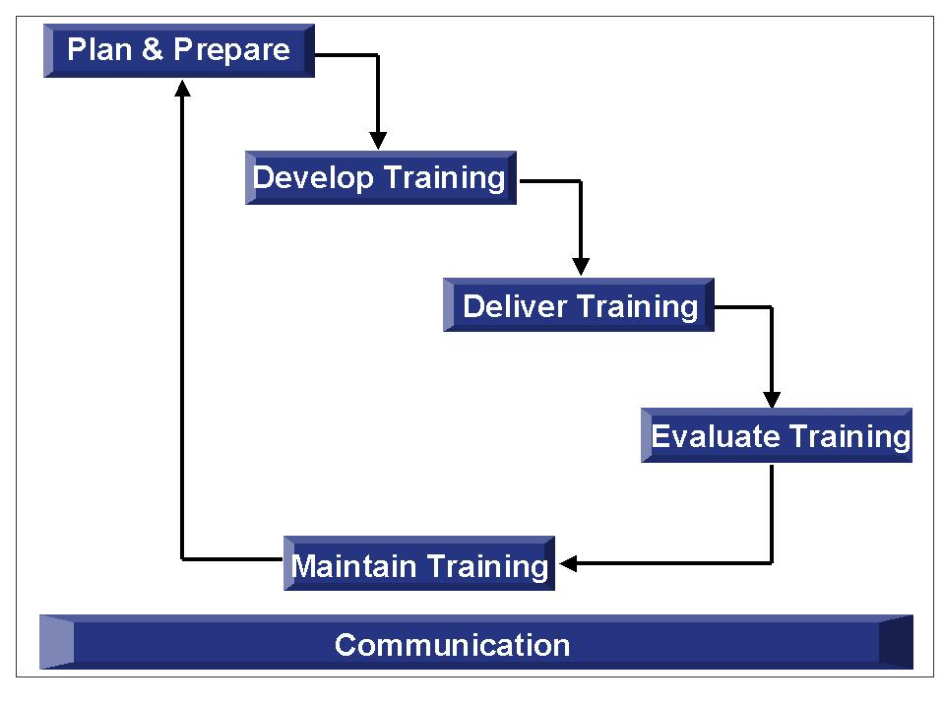
A training strategy must be developed to identify a structure and roadmap based on the learning needs of the Casper core team and end users
Components:
  Training needs assessment for core team and end users
  High level training content design
  Plan and schedule for core team training
  End user training strategy for BR1
Sample

Slide 35
Suggested Governance Model for Casper Going Forward

Slide 36
Project Casper is one of many initiatives Katz is currently planning or executing. Effective program and project governance is essential to accelerating realization of benefits
Program Governance is the selection and ongoing co-ordination of a portfolio of projects that together, will achieve benefits of strategic importance.
The objectives of the Katz Program Governance Model and Process are to ensure that:
  the right projects are being done, appropriately funded and prioritized to meet Katz needs;
  projects are being well managed (properly staffed, delivered to budget and on schedule);
  cross project dependencies are considered and managed at the appropriate level;
  expected, unexpected and realized benefits are continually assessed for business contribution and value;
  progress, issues and necessary changes are managed at the appropriate level to support the entire program, realize the strategic objectives and deliver business value.
Benefits
Business Strategy
Program
Project
Project
Casper
Casper
Project

Slide 37
Recommended governance organization model and roles
Responsible for the coordination and consolidation of the program
Manages the program Governance Organization and activity
Approves program related changes within authority level
Resolves program level issues within authority level
Usually a member of the Steering Committee
Typically reviews individual project and program progress on a weekly basis
Reviews and directs overall program for strategic enablement and business contribution.
Typically involved on a major event or achievement basis
Corporate Executive
Reviews and directs the program’s progress for strategic enablement and business contribution
Approves major program changes
Resolves escalated program issues
Typically meets on a bi-weekly or monthly basis.
Program Steering Committee
Responsible for the contribution derived from specific projects
Approves project related changes
Resolves project level issues
Usually a member of the Steering Committee
Typically reviews project progress on a weekly basis
Project Sponsor(s)
Program Manager(s)
Project Sponsor(s)
Program/Project Management Office
Project Casper Sponsor(s)
Provides project and program administration and coordination services
Project Manager(s)
Responsible for the effective delivery of individual projects to quality standards, schedule and budget
Identifies and presents additional opportunities
Project Manager(s)
Project Manager(s)

Slide 38
Each project will be managed individually and as part of the overall program
Project Casper
Project 2
(POS)
Program Objectives
Project 3
(ERP)
Program Dependency
Project Event Achieved
Business Benefit Achieved
Project Milestone Achieved
Program/Business Team Review

Slide 39
Casper Phase II

Slide 40
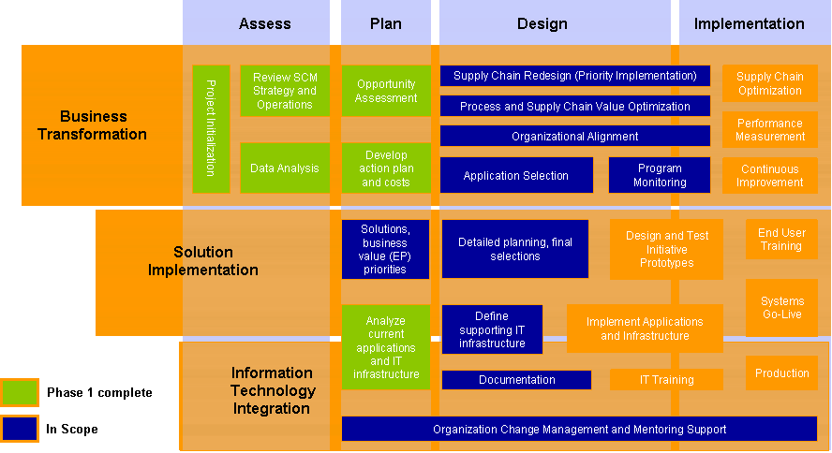
Project Casper’s Phase II will focus on continuing the journey we started on April 7 …

Slide 41
… and focus on capturing immediate benefits, designing the supply chain, selecting a retail management solution meeting KGC’s future business requirements and preparing for the implementation
SUPPLY CHAIN DESIGN
  Determine “To Be” Business and Process Capabilities
  Target Future Business Capabilities
  Future Process Attributes (FPA's)
  Identify Business Requirements Matrix
  Update Release Plan
  Define Future Organizational Change Management Requirements
  Define Future IT Infrastructure Requirements
SOLUTION SELECTION
  Applications Requirements Analysis & Selection Criteria
  RFP Preparation
  Evaluate RFP Responses & Select Finalists
  Perform Vendor demos
  Select Finalist
  Perform High Level Package Gap/Risk Analysis
QUICK HITS
  Develop approach to realize the quick hits identified in Phase I
  Assist Katz in executing the approach
LOGISTICS STRATEGY
  Determine Case for Change for use of a 3PL for the front store
  Identify opportunities to optimize/reduce the supply chain costs governed by the McKesson contracts
  Determine “To Be” Logistics Strategy
PREPARE FOR IMPLEMENTATION
  Refine the Business Case
  Update the Implementation Strategy
  Update the Organizational Change Management Strategy
  Develop Deployment and Core Team Training Strategy
  Prepare Implementation Scope and Approach

Slide 42
Our Anticipated Timeline
Based on our current understanding of Katz’s requirements, our anticipated project duration is approximately five months.
The sixth month will be spent in negotiations with the vendor and contracting for which there may or may not be need for external assistance.
Anticipated Timeline (in weeks)
Anticipated Timeline (in months)
Jul 03
Aug 03
Sep 03
Oct 03
Nov 03
Dec 03
Design & Solution Selection Project
Assessment and Planning Project
Project Launch
Supply Chain Design
Solution Selection
Logistics Strategy
Quick Hits
Prepare for Implementation
Project Initialization
Steering Committee Meetings

Slide 43
Conclusions

Slide 44


Conclusions
Our tangible deliverables for this project were:
  Executive understanding and commitment to vision
  List of opportunities for improvement
  Business case for opportunities
  Quick Wins identified and Quick Wins Team activated
  Action plan for moving forward
Project management summary:
  Time: Target was to complete the project in 12 weeks; we’ll be done in11 weeks
  Costs: IBM fees were estimated to be $375K; currently, our projected cost is $325K
  Expenses: Estimate was ~$18K for travel to stores; total amount will be ~$12K
Immediate next steps
  Executive acceptance of this presentation and the business case
  Steering Committee acceptance of Phase I deliverables
  Steering Committee approval to move forward with Casper Phase II
  Estimates of next phase of work will be submitted to Grant later this week
  Need to move quickly to keep the momentum in place and the team intact
  Press this button: ---------→

Slide 45
The End

